Slide 1

Applied Data Science Capstone Project
Opening a GYM in New York City

Slide 2
Where?
New York City is famous for all the gyms and fitness centers that are open 24/7 all around the city.
Therefore, it is a challenging choice to find the right location when entering the market.

Slide 3
Manhattan
My client would like start in Manhattan; thus, we will be focusing on this borough throughout the analysis.

Slide 4
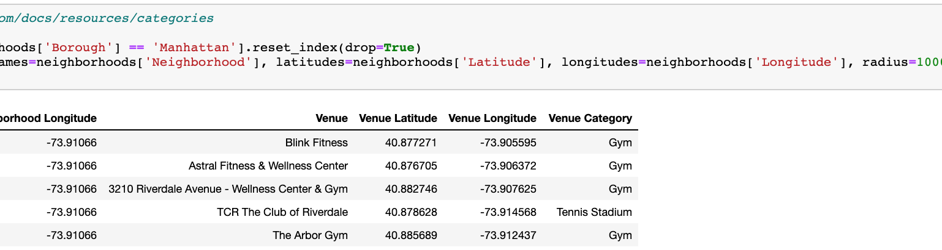
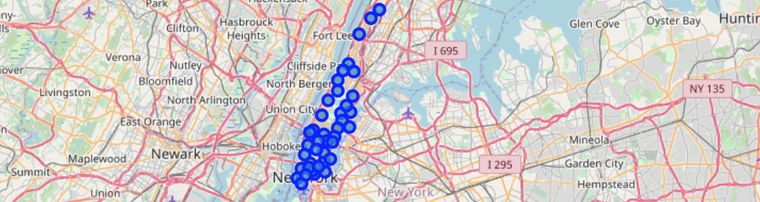
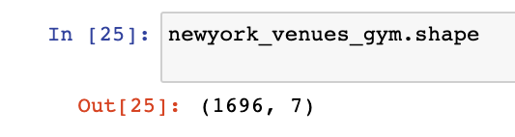

Data
01
02
Category
Let’s find the category using Foursquare API
Location
We are using Google Maps API to find geographic coordinates
Quite a lot
03
There are 1696 gyms in New York
Our dataset is available for free.
Feel free to use it:
https://cocl.us/new_york_dataset'

Slide 5

Methodology
Converting addresses to latitude and longitude
Applying Foursquare API to explore neighborhoods in Manhattan
Creating a map of all gyms in Manhattan

Slide 6
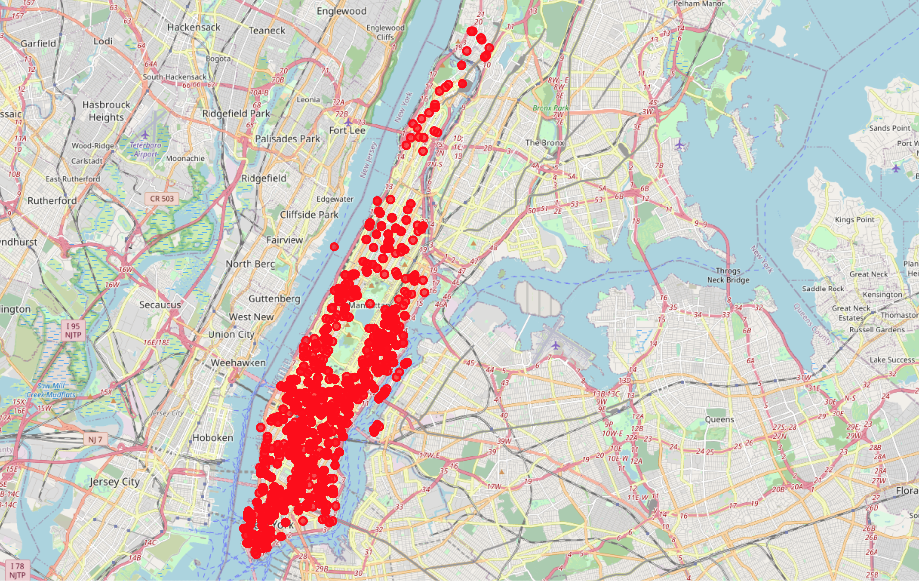
Gyms in Manhattan

Slide 7
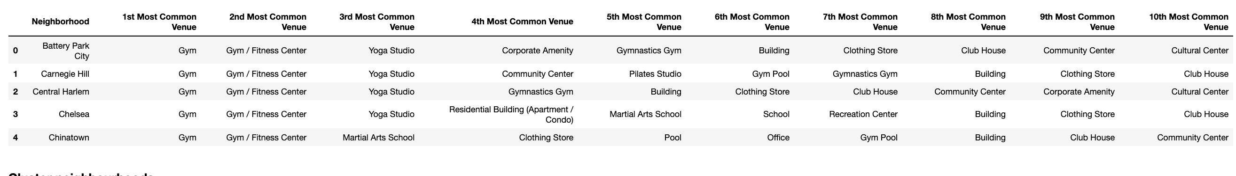
Create columns according to the most common venues

Slide 8
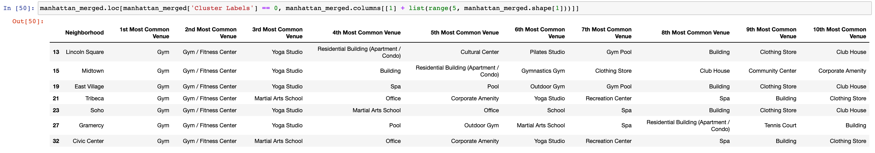
Using K-means to cluster data with less number of GYMs
Cluster 0

Slide 9
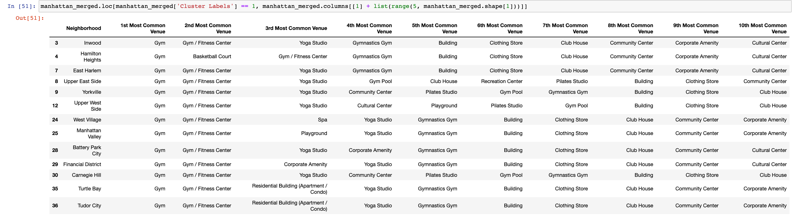
Using K-means to cluster data with less number of GYMs
Cluster 1

Slide 10
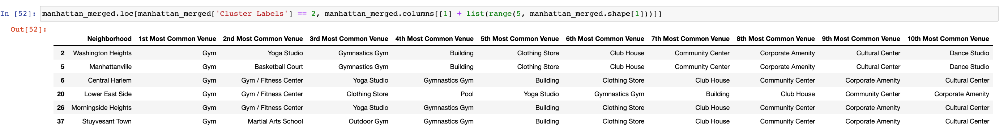
Using K-means to cluster data with less number of GYMs
Cluster 2

Slide 11
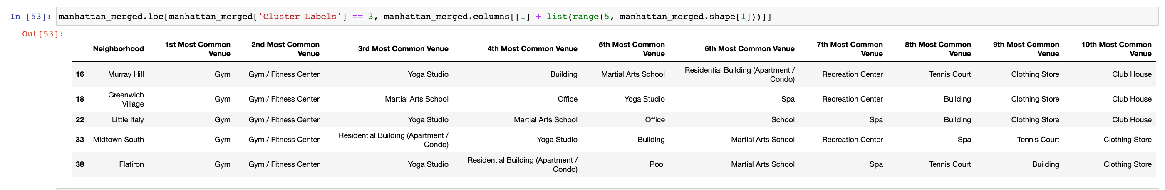
Using K-means to cluster data with less number of GYMs
Cluster 3

Slide 12
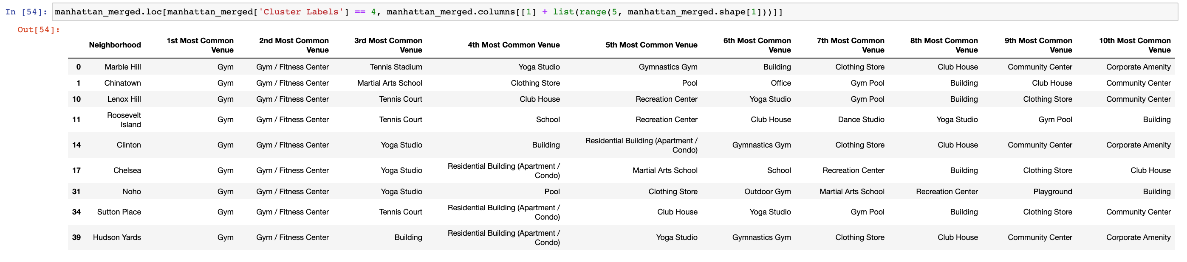
Using K-means to cluster data with less number of GYMs
Cluster 4

Slide 13

Discussion
This analysis is based on limited data, however it is sufficient for the Applied Data Science Capstone
With a more precise business plan, the potential is there to create a comprehensive and live report
Other elements, such as public transport, schools, workplace, restaurants nearby would be crucial to determine an ideal location
The aim of the project is to showcase some of the elements covered in the IBM Professional Data Science Certificate

Slide 14
THANK YOU.
OLIVER KISSZABO.

